Slide 1
Network Management : SNMP
Copyright © The McGraw-Hill Companies, Inc. Permission required for reproduction or display.

Slide 2
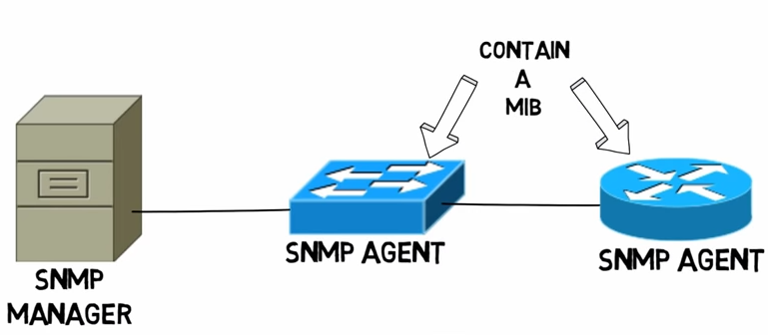
24-1 CONCEPT
It provides a set of fundamental operations for monitoring and maintaining an internet.
SNMP uses the concept of manager and agent.
Manager, usually a host, controls and monitors a set of agents, usually routers or servers.

Slide 3
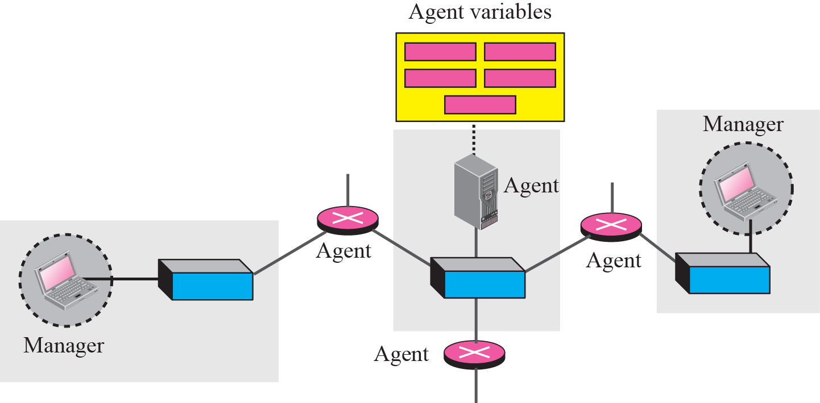
Figure 24.1 SNMP concept
SNMP is an application-level protocol in which a few manager stations control a set of agents.
It can monitor devices made by different manufacturers and installed on different physical networks.

Slide 4
Managers and Agents
A management station, called a manager, is a host that runs the SNMP client program.
A managed station, called an agent, is a router (or a host) that runs the SNMP server program.
Management is achieved through simple interaction between a manager and an agent.

Slide 5
Managers and Agents (contd)
The agent keeps performance information in a database. The manager has access to the values in the database.
router can store in appropriate variables the number of packets received and forwarded.
The manager can fetch and compare the values of these two variables to see if the router is congested or not.
The manager can also make the router perform certain actions.
router periodically checks the value of a reboot counter to see when it should reboot itself. It reboots itself, if the value of the counter is 0.
The manager can use this feature to reboot the agent remotely at any time.
It simply sends a packet to force a 0 value in the counter.
Agents can also contribute to the management process.
The server program running on the agent can check the environment and, if it notices something unusual, it can send a warning message (called a trap) to the manager.

Slide 6
Managers and Agents (contd)
Management with SNMP is based on three basic ideas:
A manager checks an agent by requesting information that reflects the behavior of the agent.
A manager forces an agent to perform a task by resetting values in the agent database.
An agent contributes to the management process by warning the manager of an unusual situation.

Slide 7
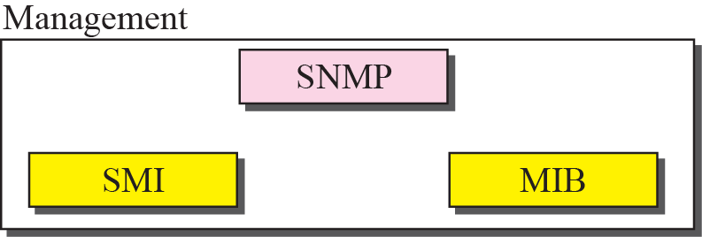
24-2 MANAGEMENT COMPONENTS
To do management tasks, SNMP uses two other protocols:
Structure of Management Information (SMI)
Management Information Base (MIB).

Slide 8
Role of SNMP
SNMP has some very specific roles in network management.
It defines the format of packet to be sent from a manager to an agent and vice versa.
It also interprets the result and creates statistics.
The packets exchanged contain the object (variable) names and their status (values).
SNMP is responsible for reading and changing these values.

Slide 9

Note
SNMP defines the format of packets exchanged between a manager and an agent. It reads and changes the status of objects (values of variables) in SNMP packets.

Slide 10
Role of SMI
To use SNMP, we need rules for naming objects.
We also need rules to define the type of the objects.
What types of objects are handled by SNMP?
Can SNMP handle simple types or structured types?
How many simple types are available?
What are the sizes of these types?
What is the range of these types?
In addition, how are each of these types encoded?
SMI is a collection of general rules to name objects and to list their types.
The association of an object with the type is not done by SMI.

Slide 11
Note
SMI defines the general rules for naming objects, defining object types (including
range and length), and showing how to encode objects and values.

Slide 12
Role of MIB
For each entity to be managed, this protocol must define the number of objects, name them according to the rules defined by SMI, and associate a type to each named object.
MIB creates a set of objects defined for each entity similar to a database

Slide 13
Note
MIB creates a collection of named objects, their types, and their
relationships to each other in an entity to be managed.

Slide 14
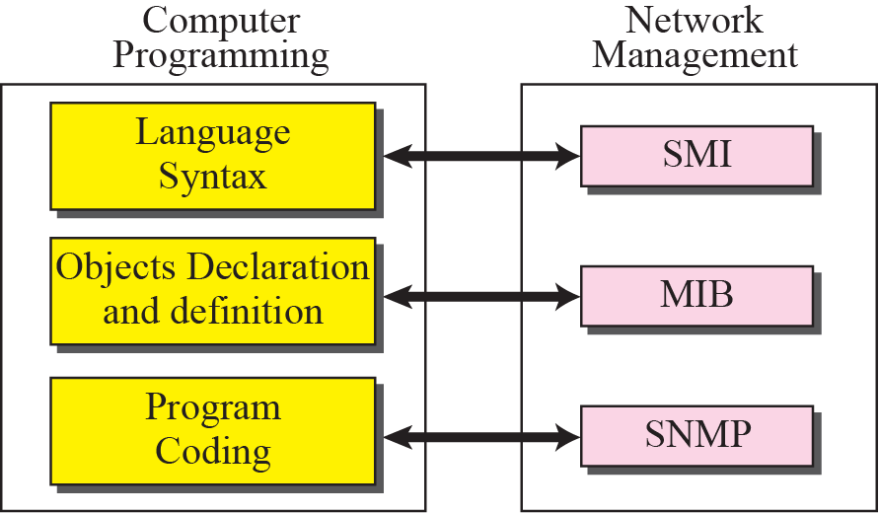
An Analogy

Slide 15
Figure 24.3 Comparing computer programming and network management
Syntax: SMI
Before we write a program, the syntax of the language must be predefined.
The language also defines the structure of variables (simple, structured and so on) and how the variables must be named.
The language also defines the type of data to be used (integer, float, char, etc.).
In programming the rules are defined by the syntax of the language.
In network management the rules are defined by SMI.

Slide 16

Figure 24.3 Comparing computer programming and network management
Object Declaration and Definition: MIB
computer languages require that objects be declared and defined in each specific program.
Declaration and definition creates objects using predefined type and allocates memory location for them.
MIB does this task in network management.
MIB names each object and defines the type of the objects.
Program Coding: SNMP
After declaration in programming, the program needs to write statements to store values in the variables and change them if needed.
SNMP does this task in network management.
SNMP stores, changes, and interprets the values of objects already declared by MIB according to the rules defined by SMI.

Slide 17
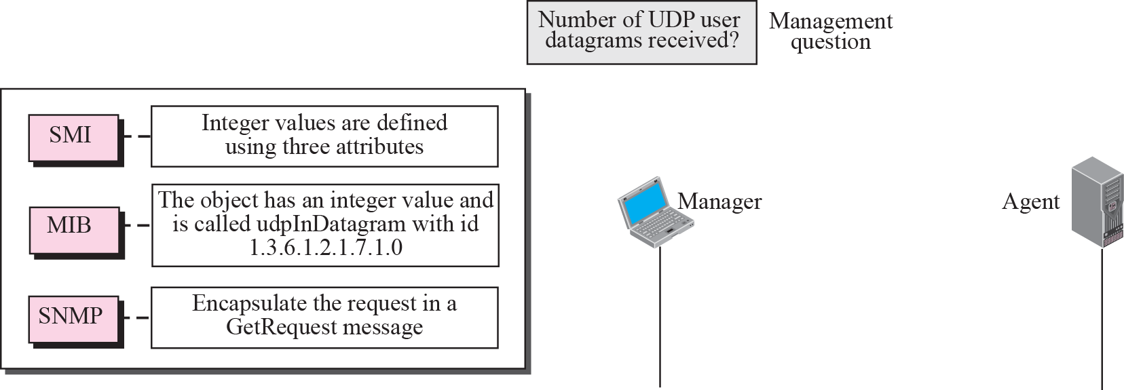
Figure 24.4 Management overview
An Overview
simple scenario : how each of these components is involved
A manager station (SNMP client) wants to send a message to an agent station (SNMP server) to find the number of UDP user datagrams received by the agent.

Slide 18
24-3 SMI
The Structure of Management Information is a component for network management. Its functions are:
To name objects.
To define the type of data that can be stored in an object.
To show how to encode data for transmission over the network.
It emphasizes 3 attributes to handle an object: name, data type, and encoding method.

Slide 19
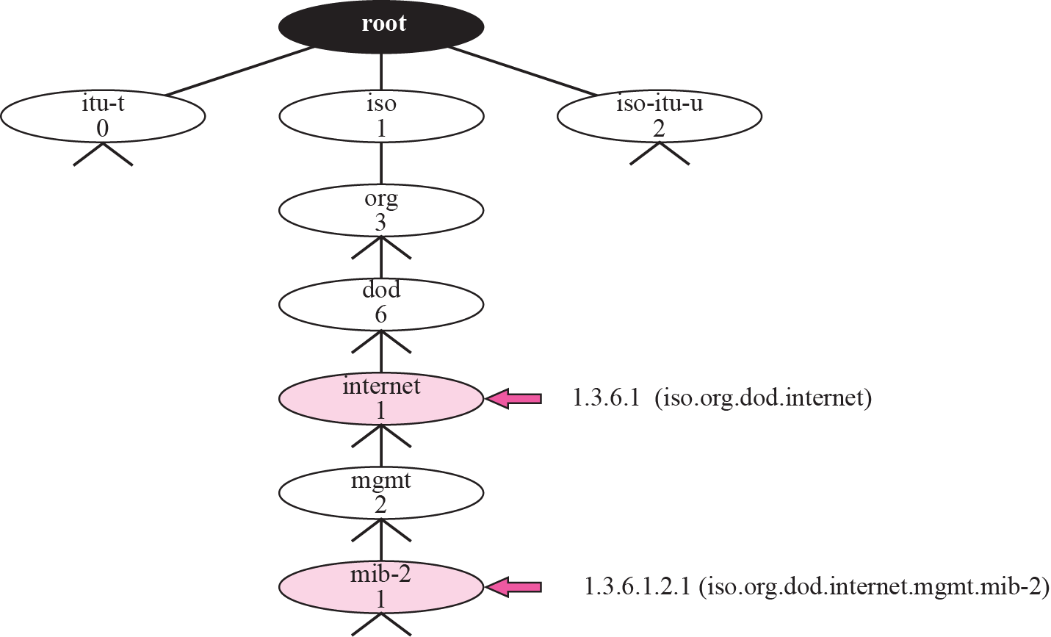
Figure 24.5 Object identifier
Name
SMI requires that each managed object (such as a router, a variable in a router, a value, etc.) have a unique name.
To name objects globally, SMI uses an object identifier, which is a hierarchical identifier based on a tree structure.
Figure 24.5 Object identifier

Slide 20
Figure 24.5 Object identifier
Name (contd)
The tree structure starts with an unnamed root.
Each object can be defined using a sequence of integers separated by dots.
The tree structure can also define an object using a sequence of textual names separated by dots.
The integer-dot representation is used in SNMP. The name-dot notation is used by people.
Following shows the same object in two different notations:

Slide 21
The objects that are used in SNMP are located under the mib-2 object, so their identifiers always start with 1.3.6.1.2.1.
All objects managed by SNMP are given an object identifier.
The object identifier always starts with 1.3.6.1.2.1.

Slide 22
Type
The second attribute of an object is the type of data stored in it.
SMI has two broad categories of data type: simple and structured.

Slide 23
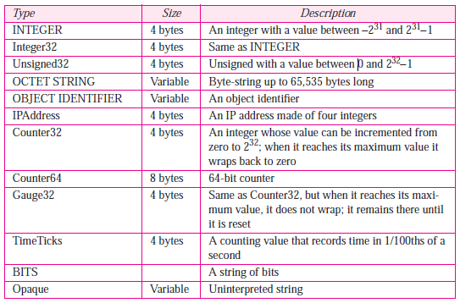
Simple Type
The simple data types are atomic data types.

Slide 24
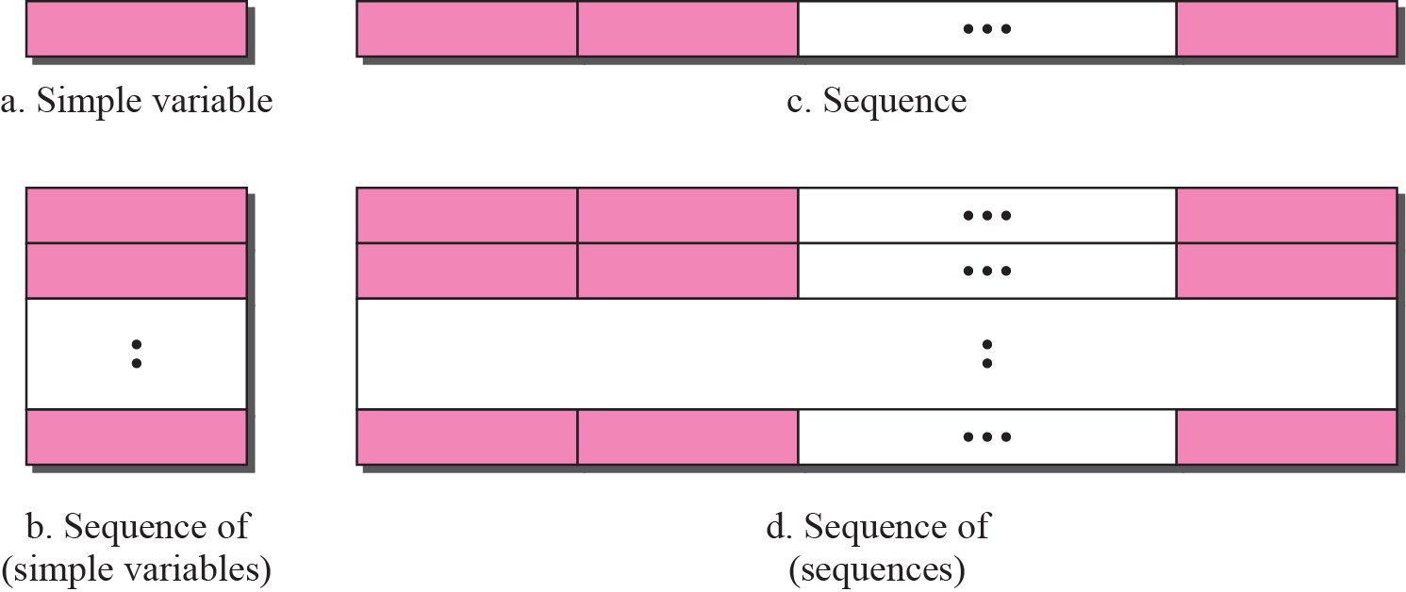
Figure 24.6 Conceptual data types
Structured Type
By combining simple and structured data types, we can make new structured data types.
SMI defines two structured data types: sequence and sequence of.
Sequence.
A sequence data type is a combination of simple data types, not necessarily of the same type. It is analogous to struct in C.
Sequence of.
A sequence of data type is a combination of simple data types all of the same type or a combination of sequence data types all of the same type. It is analogous to array

Slide 25
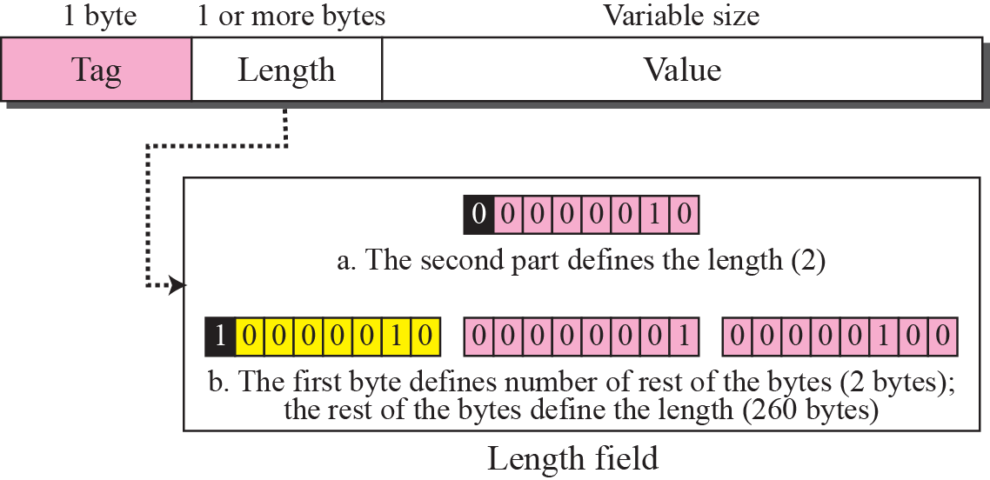
Figure 24.7 Encoding format
Encoding Method
SMI uses another standard, Basic Encoding Rules (BER), to encode data to be transmitted over the network.
In BER each piece of data be encoded in triplet format: tag, length, and value.
Figure 24.7 Encoding format

Slide 26
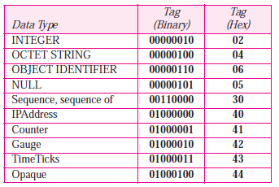
Figure 24.7 Encoding format
The tag is a 1-byte field that defines the type of data.
Table shows the data types (few ) and their tags in binary and hexadecimal numbers.
The length field is 1 or more bytes.
If it is 1 byte, most significant bit must be 0. The other 7 bits define the length of the data.
If it is more than 1 byte, the most significant bit of the first byte must be 1.
The other 7 bits of the first byte define the number of bytes needed to define the length.
The value field codes the value of the data according to the rules defined in BER.

Slide 27
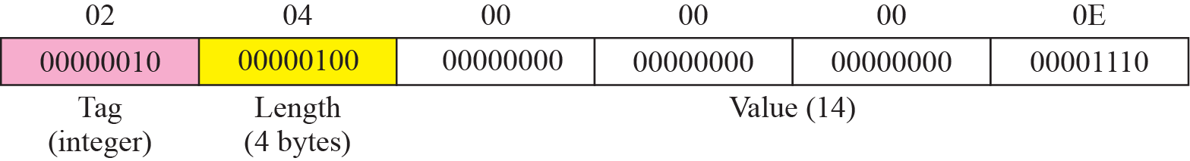
Example 24.1
Figure shows how to define INTEGER 14.
Here used both binary representation and hexadecimal representation for the tag.

Slide 28
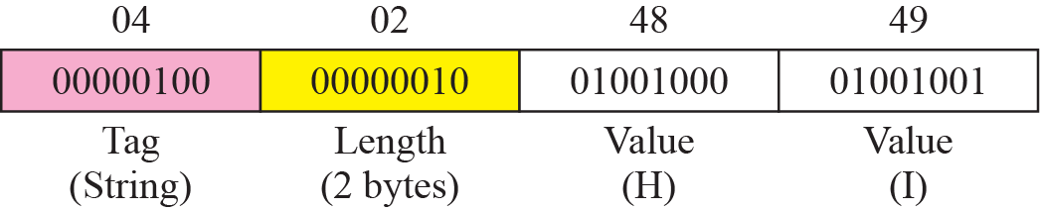
Example 24.2
Figure shows how to define the OCTET STRING “HI.”

Slide 29
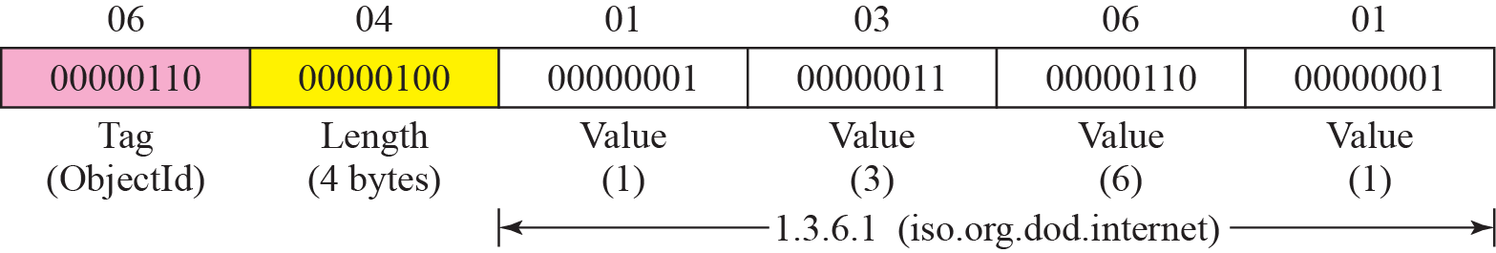
Example 24.3
Figure shows how to define ObjectIdentifier 1.3.6.1 (iso.org.dod.internet).

Slide 30
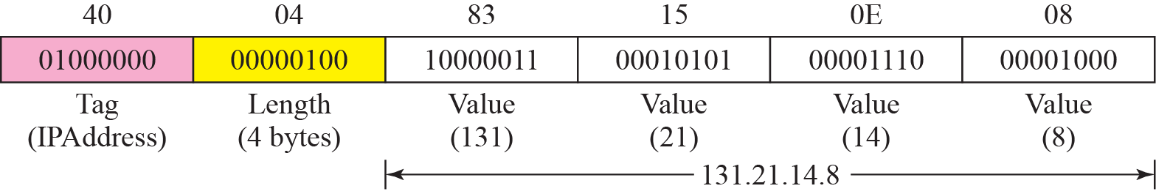
Example 24.4
Figure shows how to define IPAddress 131.21.14.8.

Slide 31
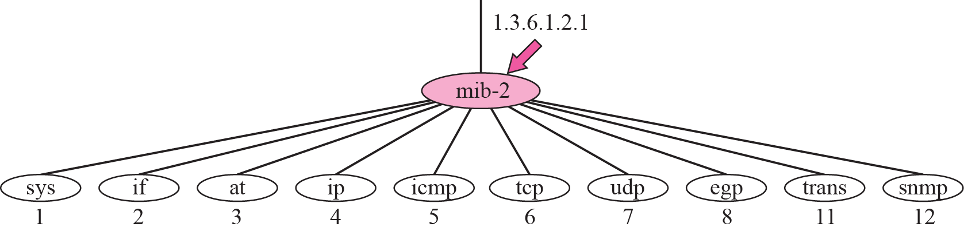
24-4 MIB
The Management Information Base, version 2 (MIB2) is the second component used in network management.
Each agent has its own MIB2, which is a collection of all the objects that the manager can manage.
The objects in MIB2 are categorized under 10 different groups: system, interface, address translation, ip, icmp, tcp, udp, egp, transmission, and snmp.
These groups are under the mib-2 object in the object identifier tree.
Each group has defined variables and/or tables.

Slide 32
Figure 24.12 mib-2
sys This object (system) defines general information about the node (system), such as the name, location, and lifetime.
if This object (interface) defines information about all of the interfaces of the node including interface number, physical address, and IP address.
at This object (address translation) defines the information about the ARP table.
ip This object defines information related to IP, such as the routing table and the IP address.
icmp This object defines information related to ICMP, such as the number of packets sent and received and total errors created.
tcp This object defines general information related to TCP, such as the connection table, time-out value, number of ports, and number of packets sent and received.
udp This object defines general information related to UDP, such as the number of ports and number of packets sent and received.
snmp This object defines general information related to SNMP itself.

Slide 33
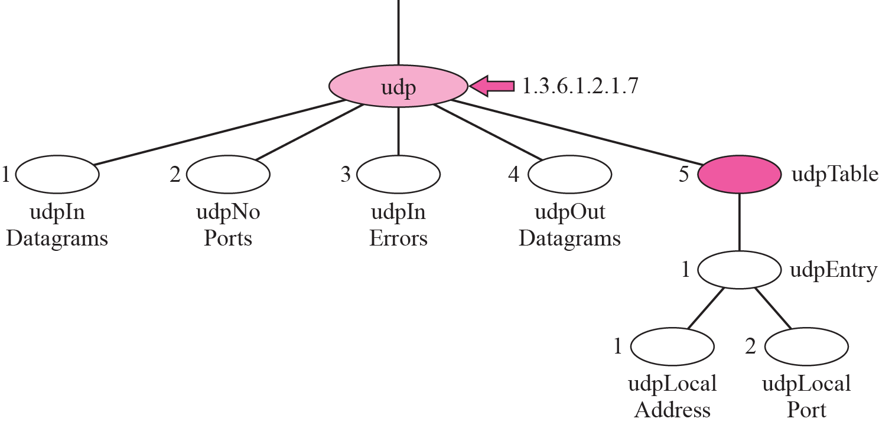
Figure 24.13 udp group
Accessing MIB Variables
Here used the udp group as an example.
There are four simple variables in the udp group and one sequence of (table of) records.
Figure shows the variables and the table.

Slide 34


Simple Variables
To access any of the simple variables, use id of the group (1.3.6.1.2.1.7) followed by the id of the variable.
These object identifiers define the variable, not the instance (contents). To show the instance or the contents of each variable, we must add an instance suffix. The instance suffix for a simple variable is simply a zero.

Slide 35
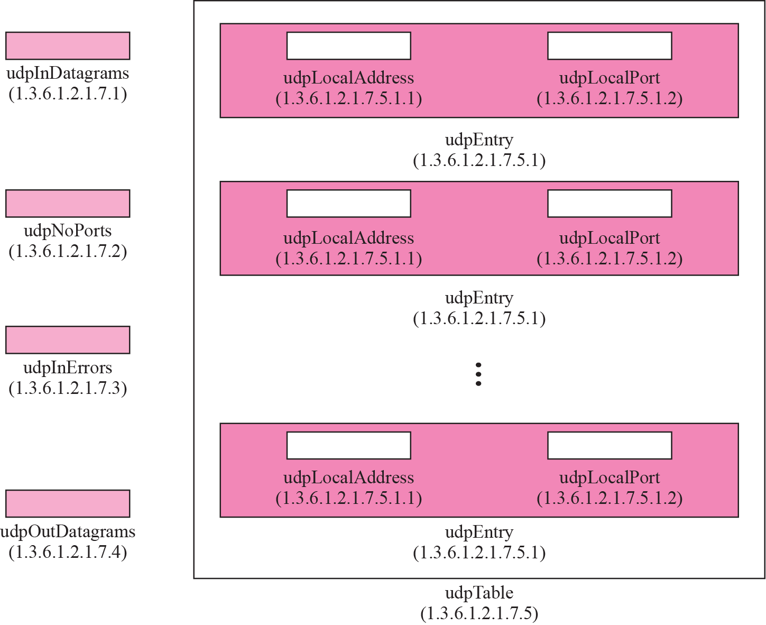

Figure 24.14 udp variables and tables
Tables
To identify a table, we fuse the table id. The udp group has only one table (with id 5).
So to access the table, we use the following:

Slide 36

Figure 24.14 udp variables and tables
table is not at the leaf level in the tree structure. We cannot access the table; we define the entry (sequence) in the table (with id of 1), as follows:
This entry is also not a leaf and we cannot access it. We need to define each entity (field) in the entry.
Although we can access their instances, we need to define which instance. At any moment, the table can have several values for each local address/local port pair. To access a specific instance (row) of the table, we add the index to the above ids.

Slide 37
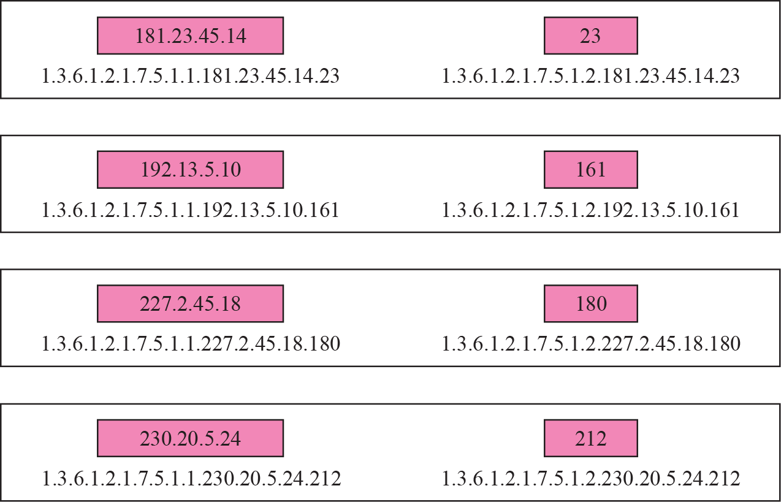
Figure 24.15 Indexes for udpTable
Figure 24.15 shows a table with four rows and values for each field.
The index of each row is a combination of two values.

Slide 38
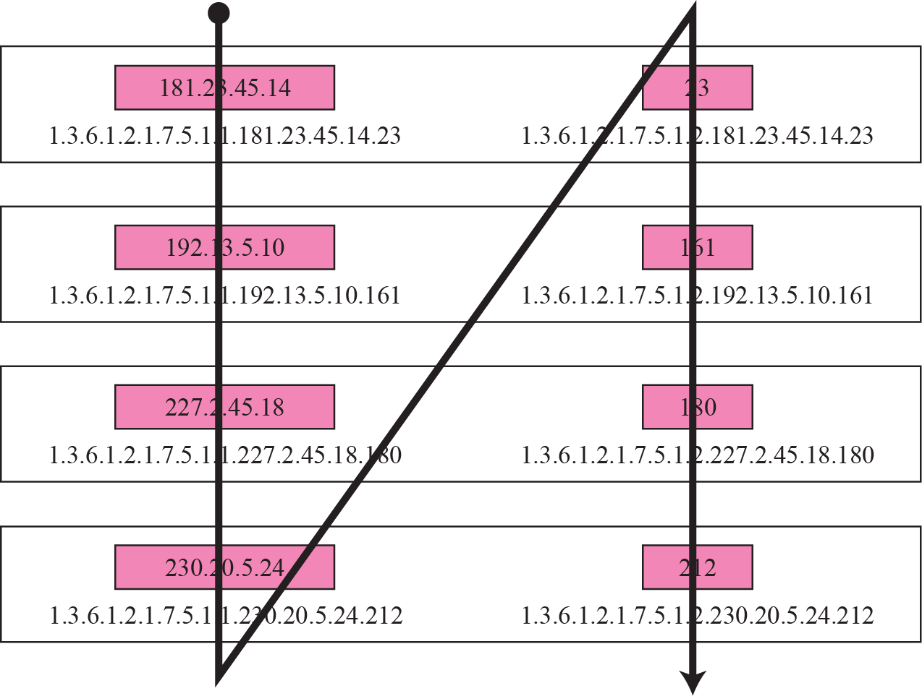
Figure 24.16 Lexicographic ordering
Lexicographic Ordering
One interesting point about the MIB variables is that the object identifiers (including the instance identifiers) follow in lexicographic order.
Tables are ordered according to column-row rules, which means one should go column by column.
In each column, one should go from the top to the bottom.
The lexicographic ordering enables a manager to access a set of variables one after another by defining the first variable, as we will see in the GetNextRequest command in the next section

Slide 39
24-5 SNMP
SNMP uses both SMI and MIB in Internet network management.
It is an application program that allows:
1. A manager to retrieve the value of an object defined in an agent.
2. A manager to store a value in an object defined in an agent.
3. An agent to send an alarm message about an abnormal situation to the manager.

Slide 40
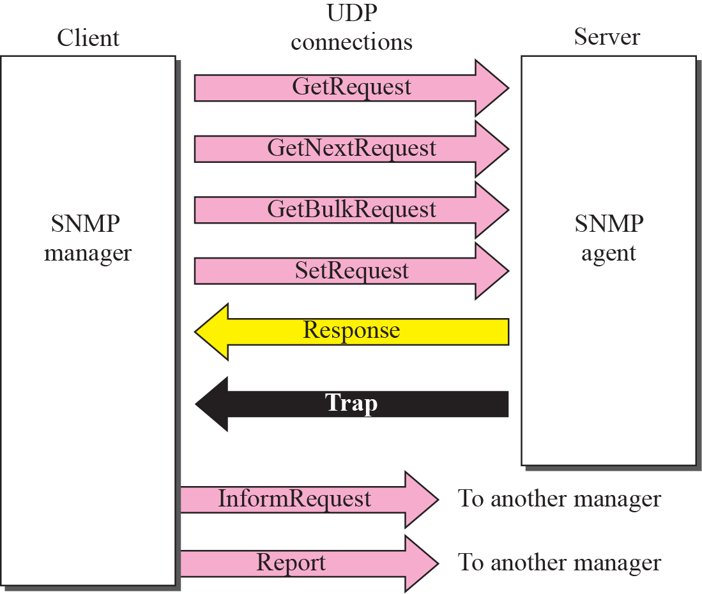
Figure 24.17 SNMP PDUs
PDUs
SNMPv3 defines 8 types of protocol data units (or PDUs): GetRequest, GetNext-Request, GetBulkRequest, SetRequest, Response, Trap, InformRequest, and Report.

Slide 41
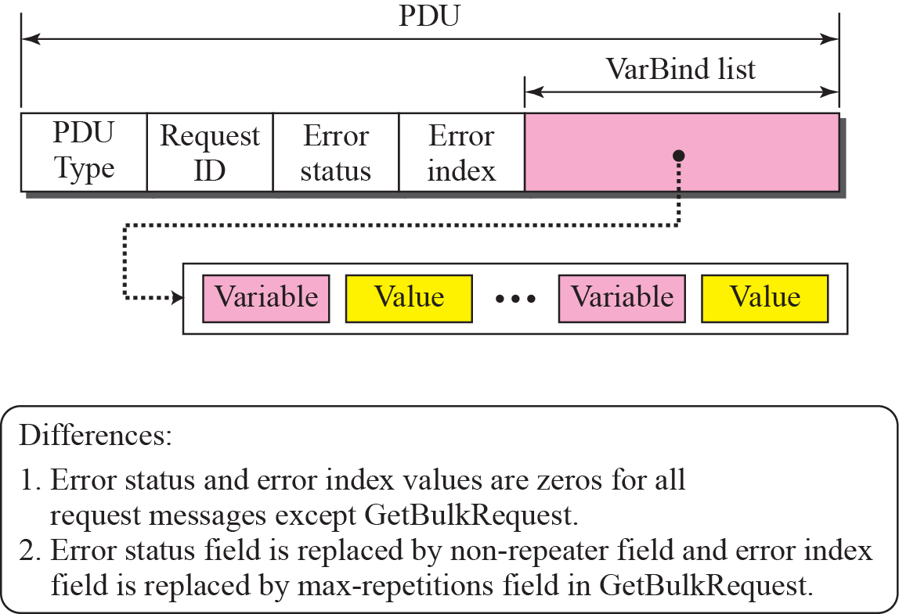
Figure 24.18 SNMP PDU format
Format
The format for the eight SNMP PDUs.
The GetBulkRequest PDU differs from the others in two areas

Slide 42
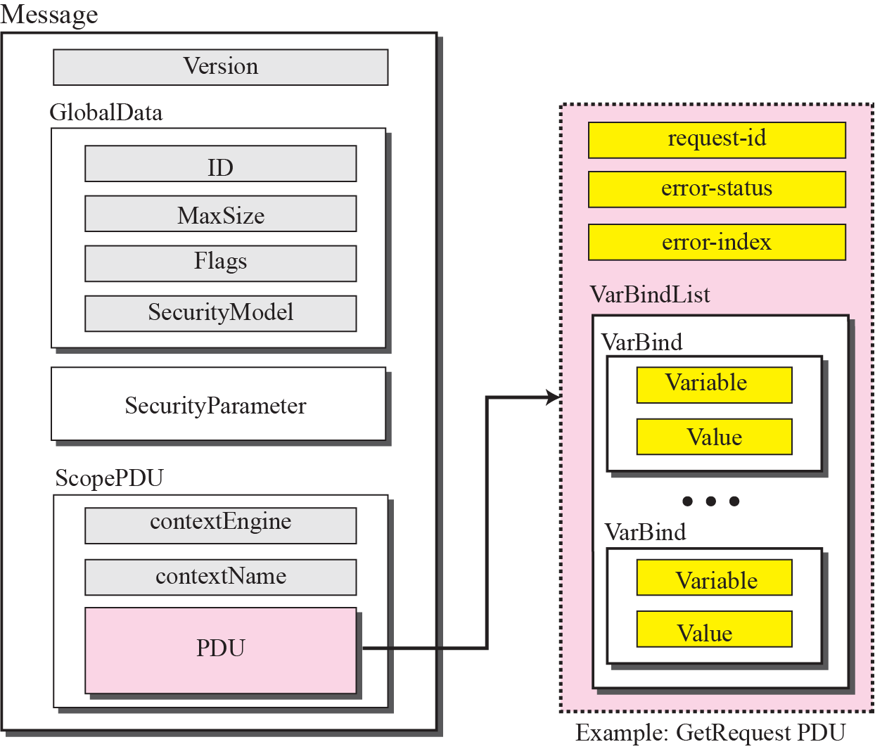
Figure 24.19 SNMP message
Messages
SNMP does not send only a PDU, it embeds the PDU in a message.
A message in SNMPv3 is a sequence made of four elements: Version, GlobalData, SecurityParameters, and ScopePDU (which includes the encoded PDU).
The first and the third elements are simple data types;
the second and the fourth are sequences.

Slide 43
Example 24.4
A manager station (SNMP client) uses a message with GetRequest PDU to retrieve the number of UDP datagrams that a router has received.
There is only one VarBind sequence.
The corresponding MIB variable related to this information is udpInDatagrams with the object identifier 1.3.6.1.2.1.7.1.0.
The manager wants to retrieve a value (not to store a value), so the value defines a null entity.
The bytes to be sent are shown in hexadecimal representation.

Slide 44
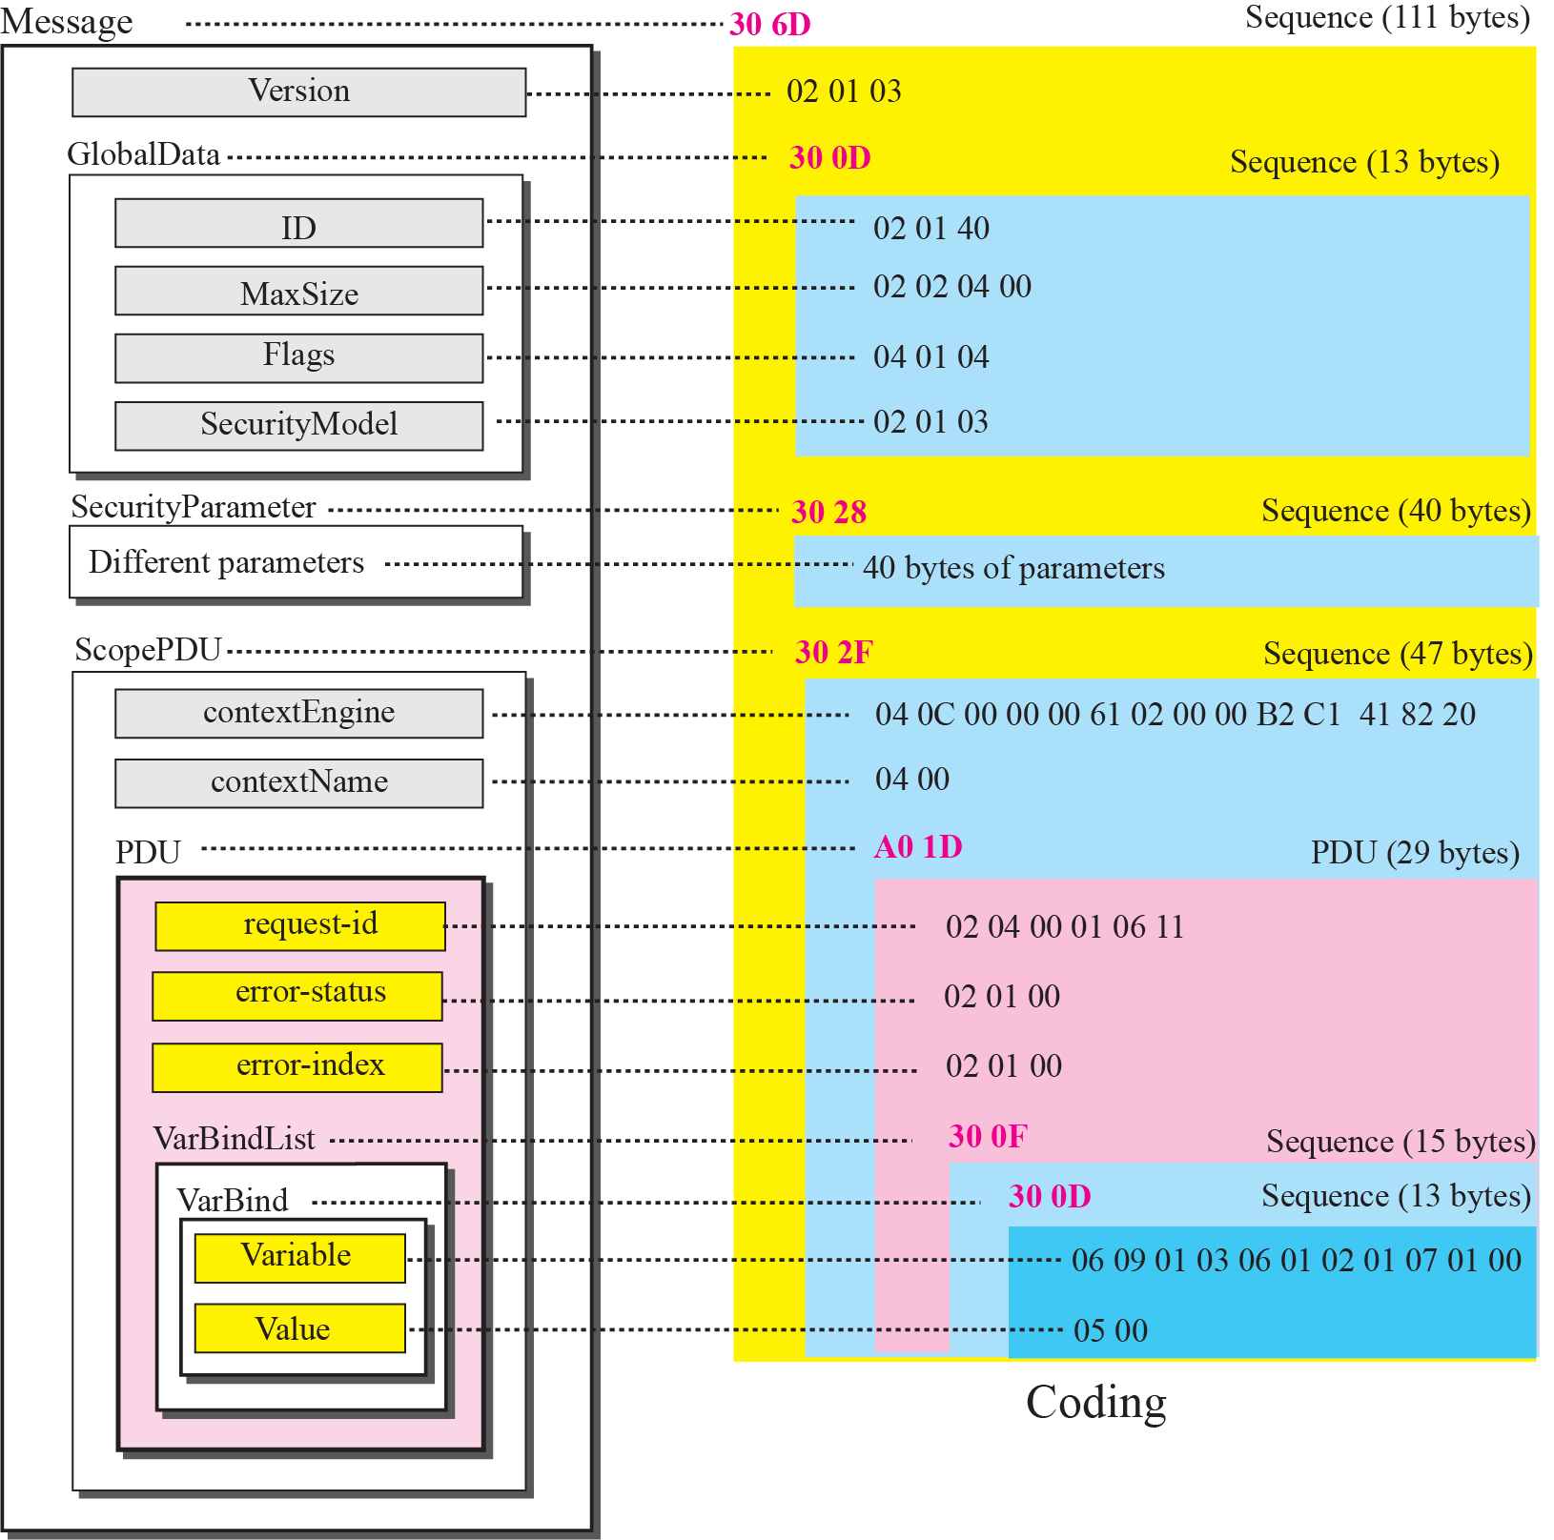
Figure 24.20 Example 24.5

Slide 45
Figure 24.20 Example 24.5
VarBind list has only one VarBind. The variable is of type 06 and length 09. The value is of type 05 and length 00.
whole VarBind is a sequence of length 0D (13). The VarBind list is also a sequence of length 0F (15).
The GetRequest PDU is of length 1D (29). The PDU is embedded in ScopePDU sequence, which is of 47 bytes.
The Security Parameters assumed to be 40 bytes.
The GlobalData itself is a sequence of 13 bytes. Three sequences and one integer (version) are embedded in the message sequence, which is the length of 111 bytes. The whole message is of 113 bytes.

Slide 46
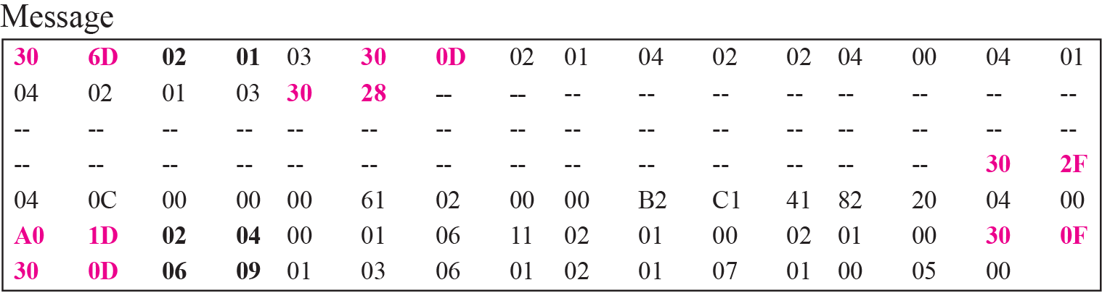
Figure 24.21 Actual message sent for Example 24.5
Figure shows the actual message sent.
The bytes that are shown using dashes are the one related to the security parameters.

Slide 47
END

